Slide 1
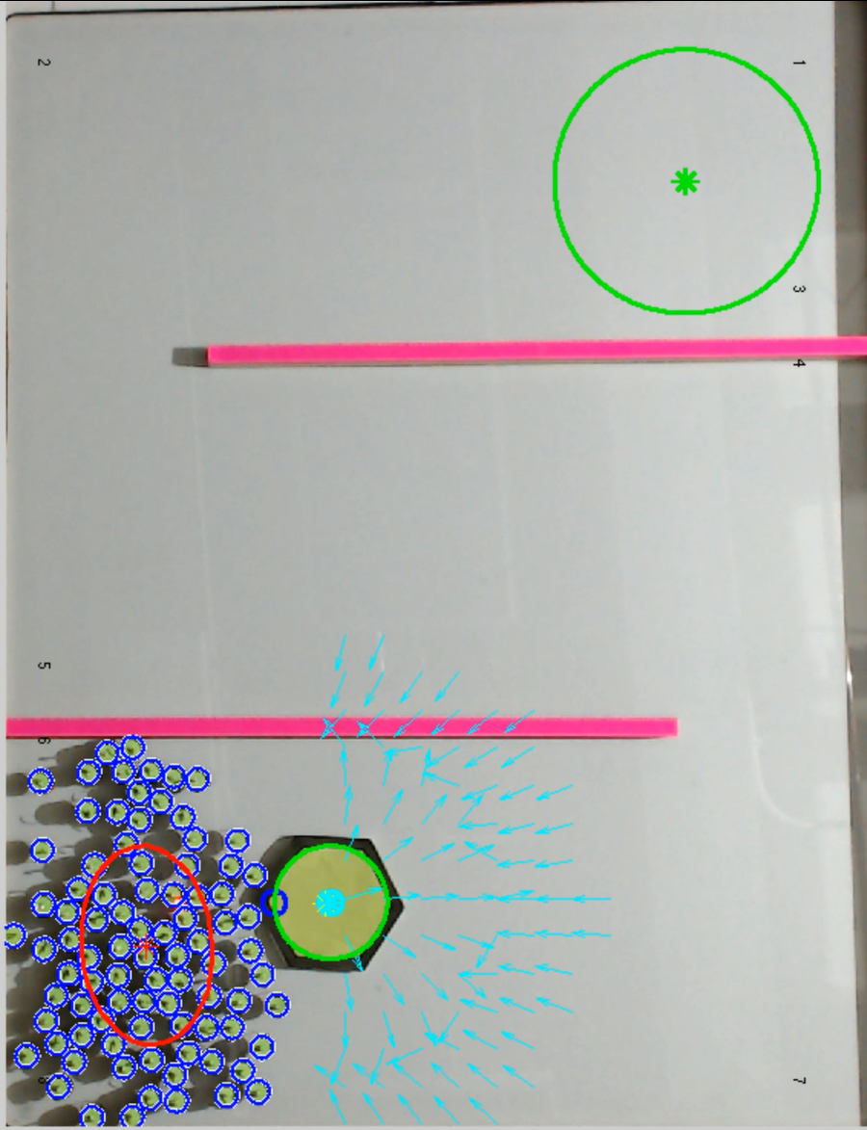
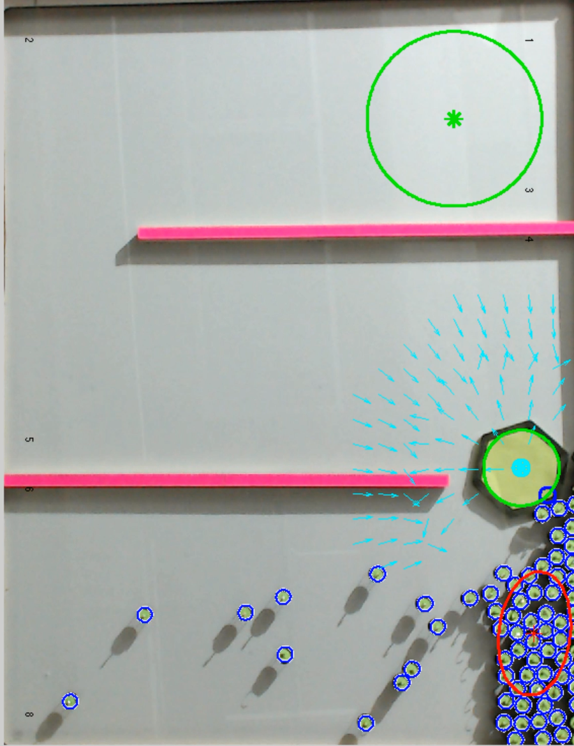
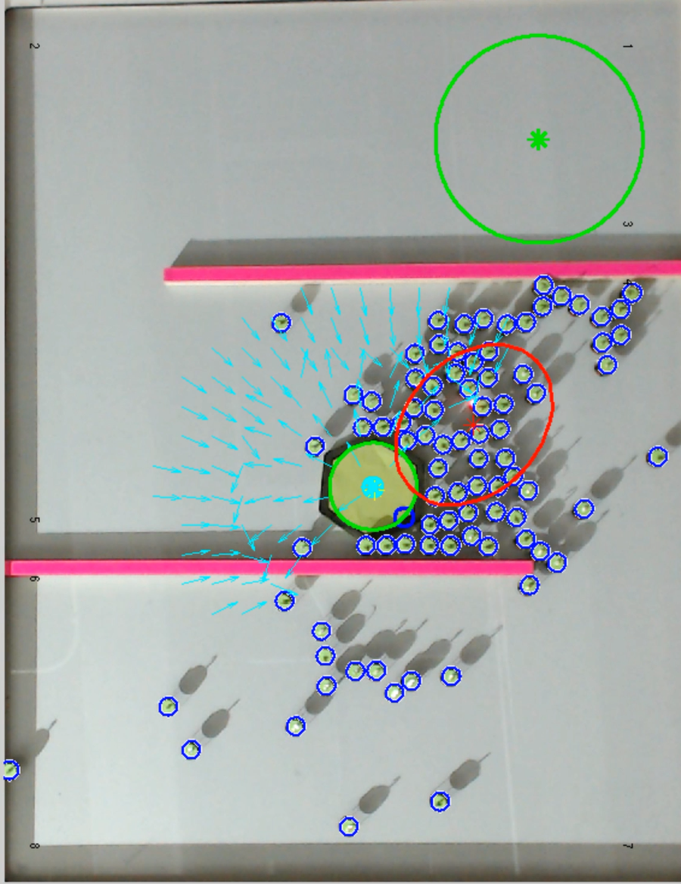
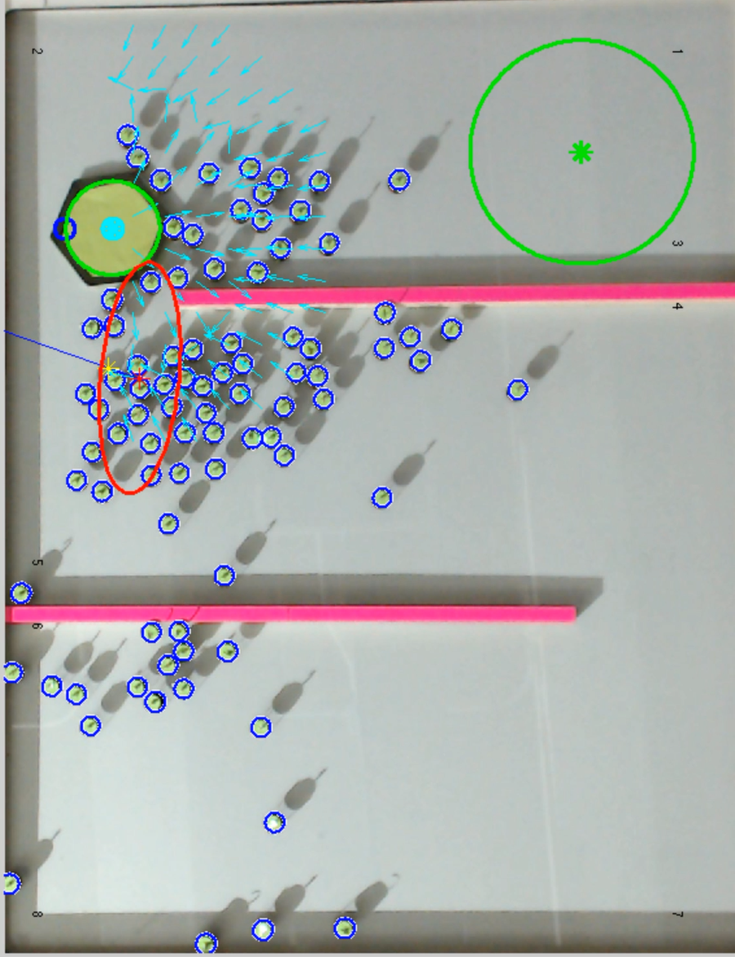
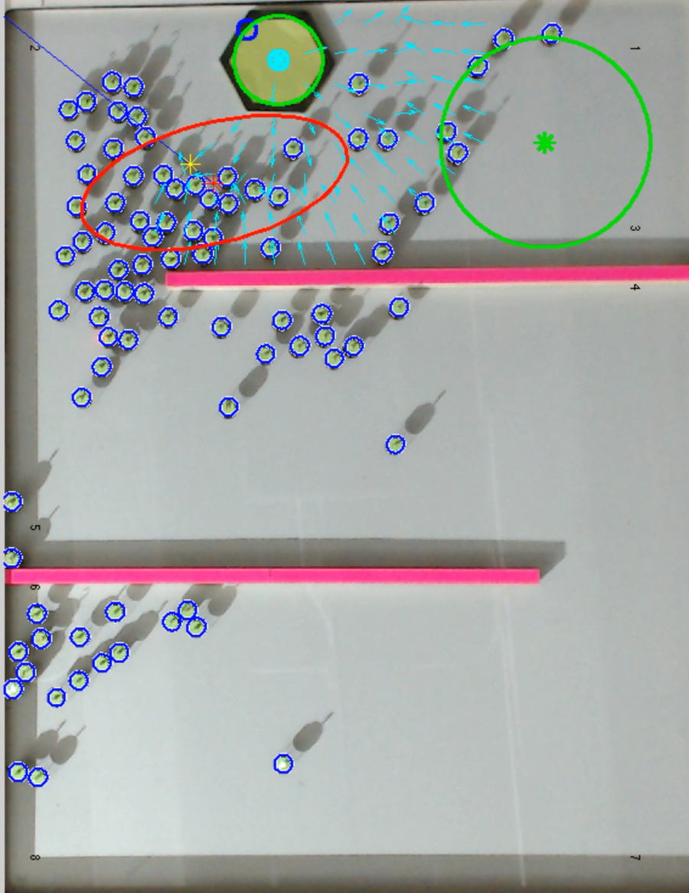
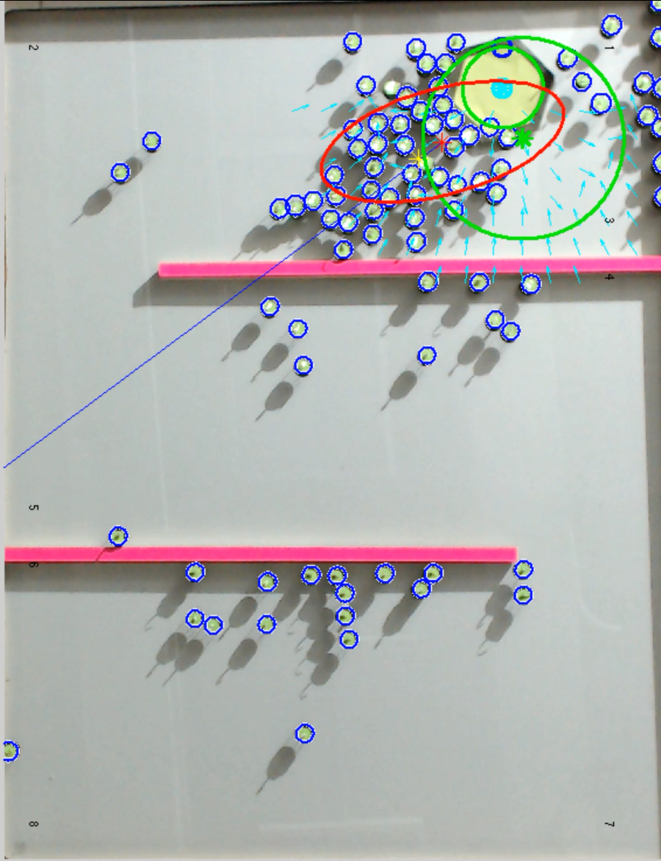
Notes:
Or time as follows 3 seconds, 6 minutes and 50 seconds, 11 minutes and 54 seconds, 22 minutes and 54 seconds, 36 minutes and 25 seconds, and 45 minutes and 3 seconds

